Slide 1
7PAM2000 Applied Data Science 1
Assignment 3: Clustering and fitting
Poster

Slide 2
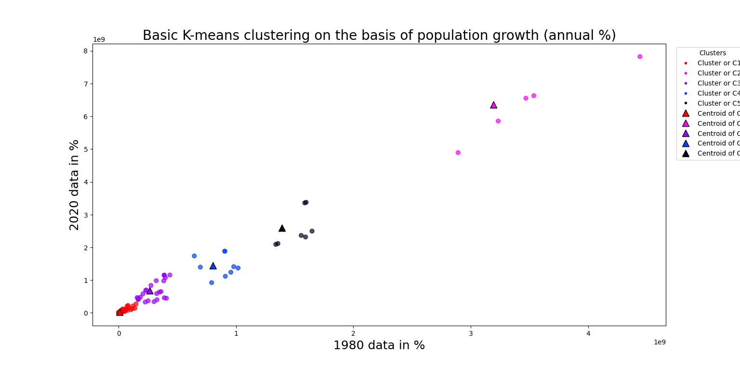
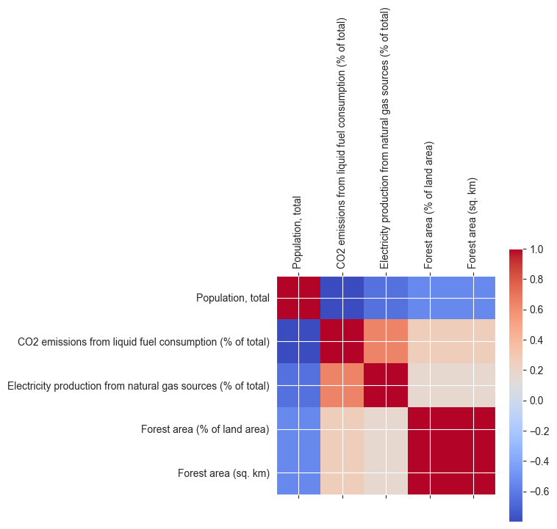
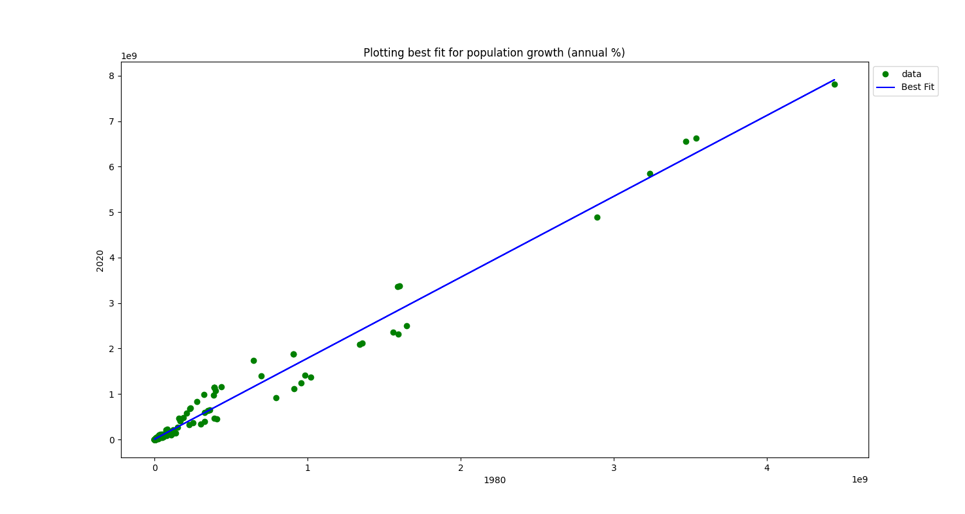
World population analysis
Introduction
This analysis, we will explore interesting clusters of data using clustering methods and fitting simple models to different datasets. Clustering will allow us to identify groups of countries with similar characteristics, such as population, or sector fractions. By normalizing the data, we can effectively compare and analyze various attributes. Additionally, we will use curve fitting to create simple models, such as exponential growth or logistic functions, to predict future values with confidence intervals. By comparing countries within and across clusters, we can identify trends, similarities, and differences, shedding light on potential patterns and relationships in the data.
The code provided performs a K-means clustering analysis on a dataset, where the focus is on population growth. The aim is to identify clusters of countries based on their population growth rates from 1980 to 2020. The code first merges the filtered data with additional data, and then computes the centroids for each cluster. The resulting centroids for the years 1980 and 2020 are extracted and plotted on a scatter plot, along with the data points. The colors represent different clusters, and legend elements are created to differentiate between clusters and centroids. This analysis helps in understanding the patterns and trends in population growth across different countries or regions.
Correlation for understanding indicators
To explore the correlation between indicators, we can analyze the following indicators: Population, total; CO2 emissions from solid fuel consumption (% of total); Electricity production from natural gas sources (% of total); Forest area (% of land area); and Forest area (sq. km). By examining these indicators, we can assess the potential relationships between population size, CO2 emissions from solid fuel consumption, reliance on natural gas for electricity production, and the extent of forest coverage both in terms of percentage and actual land area. Analyzing their correlation can provide valuable insights into the environmental impact, energy sources, and natural resources of different regions or countries.
The new_datafit function fits a linear model to a dataset using curve_fit and plots the data points and best-fitted line. The err_ranges function calculates confidence intervals. These tools help analyze relationships and estimate uncertainty in the data

